Slide 1
Data Labelling Solution of URL
Data labelling plays a crucial role in various fields, including URL classification. In this presentation, we will explore the importance of data labelling, different techniques, challenges, and best practices.

Slide 2
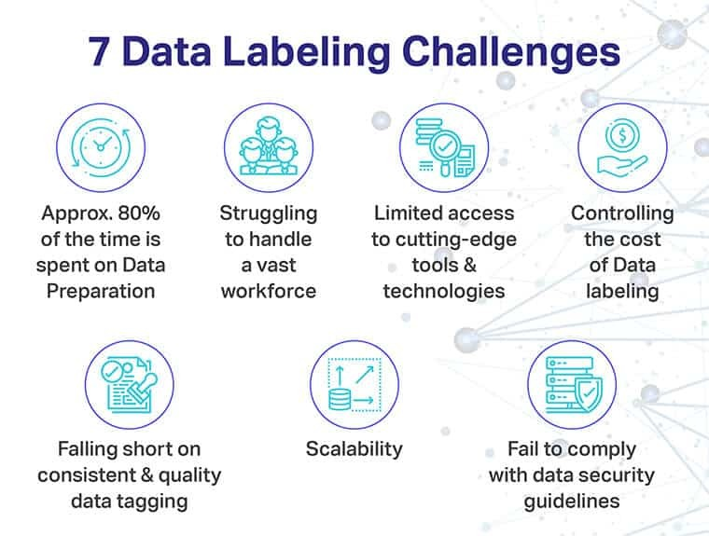
Importance & Challenges of Data Labelling
Cost and resource intensity.
Scalability issues in growing datasets.
Ensuring high data quality.
Labeling subjectivity and consistency.
Addressing privacy and security concerns.

Slide 3
Active learning Strategy Solution
1.Dataset Processing: Initially, we will do feature engineering to obtain data records with features.
2.Dataset Partitioning: We will start with a labeled dataset and partition it into three sets: training, testing, and validation. This division helps evaluate model performance on unseen data and fine-tune it iteratively.
3.Baseline Model Training: We will train baseline models using the training datasetThese models serve as the initial models to make predictions.
4.Initial Prediction: We will use the trained models to make predictions on the test dataset. We will evaluate the accuracy of the predictions.
5.Accuracy Threshold Check: We will check if the accuracy of the predictions meets a predefined threshold. If the accuracy is below the threshold, it indicates that the model needs improvement.
6.Label Correction: We will correct the labels of the misclassified instances in the test dataset. This step involves human intervention to correct the ground truth labels based on the model's predictions.
7.Data Augmentation: We will use the corrected test dataset as additional training data. This is a form of data augmentation where we iteratively incorporate new labeled data into the training set.
8.Retraining: We will retrain the models using the augmented training dataset. This step helps the models adapt to the corrected labels and potentially improve their performance.
9.Iterative Process: We will repeat the process iteratively: make predictions, check accuracy, correct labels, augment data, and retrain models. This iterative approach allows the models to learn from the corrected labels and improve over successive iterations.

Slide 4
Why Data Labelling is Necessary for URL Classification?
URL classification involves categorizing websites based on their content or potential security threats. Data labelling facilitates training machine learning models to distinguish between different categories, ensuring effective URL analysis and filtering.

Slide 5
Types of Data Labelling Techniques for URL
Manual Labelling
Human experts manually categorize URLs into different classes, providing accurate labels. This approach ensures high precision but can be time-consuming and expensive.
Active Learning
Using a combination of manual and automated techniques, active learning optimizes the labelling process by selecting specific URLs that require human validation, minimizing effort while maintaining accuracy.
Crowdsourcing
Outsourcing data labelling to a crowd of workers, leveraging their collective intelligence to label large datasets quickly. Crowdsourcing provides cost-effective solutions, but may require additional quality control measures.

Slide 6
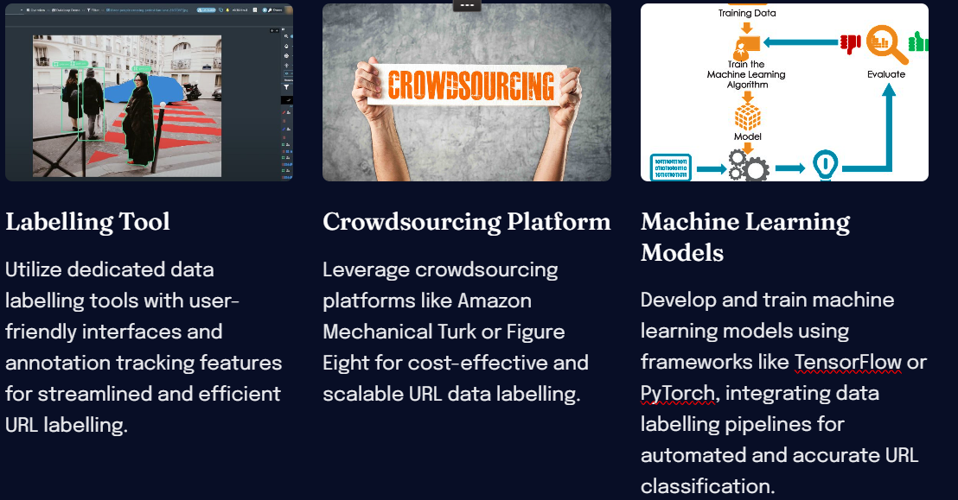
Tools and Platforms for URL Data Labelling

Slide 7
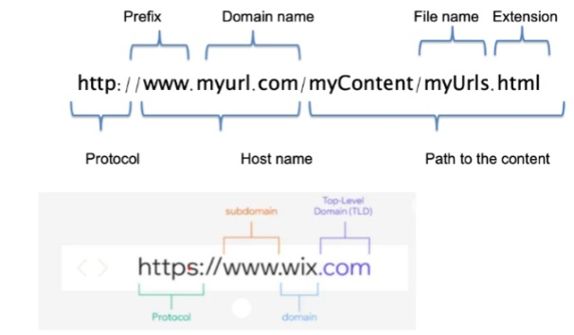
Data Overview
Taken data from Kaggle: https://www.kaggle.com/datasets/siddharthkumar25/malicious-and-benign-urls?resource=download
The dataset was acquired from various sources such as PhisTank etc.

Slide 8
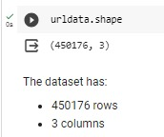
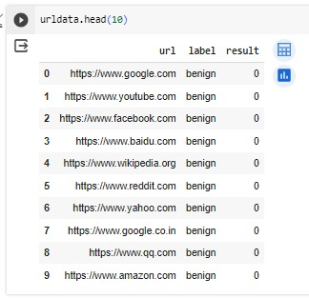
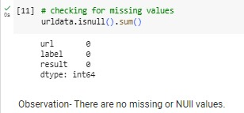
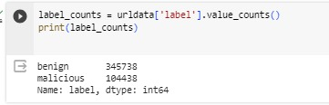

Slide 9
Feature Engineering The following features will be extracted from the URL for classification.
Length Features:
Length Of Url
Length of Hostname
Length Of Path
Length Of First Directory
Length Of Top Level Domain
Count Features:
Count Of '-'
Count Of '@'
Count Of '?'
Count Of '%'
Count Of '.'
Count Of '='
Count Of 'http'
Count of 'https'
Count Of 'www'
Count Of Digits
Count Of Letters
Count Of Number Of Directories

Slide 10
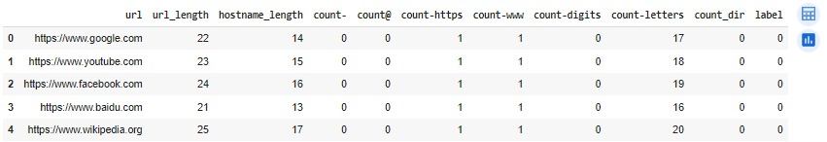
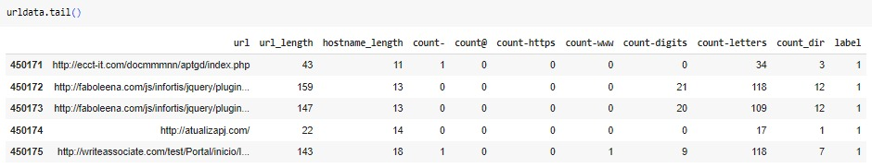

Slide 11
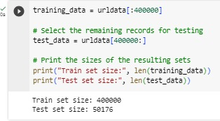
Data Partitioning into Train and test Data Set

Slide 12
Dataset trained on these models:
Logistic Regression
SGD- Stochastic Gradient Descent
SVM- Support Vector machine

Slide 13
Cross Validation Algo to be used:- Grid search CV
Grid Search CV is used for :
Hyperparameter Tuning: Identifying the best combination of hyperparameter values for a machine learning model.
Performance Evaluation: Assessing how well a model generalizes to unseen data, mitigating overfitting or underfitting issues.
Avoiding Overfitting: Ensuring that the model's hyperparameters are tuned based on its ability to generalize across different subsets of the data.
Optimal Model Selection: Comparing multiple models with different hyperparameter settings to identify the one with the best performance.

Slide 14
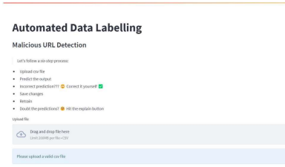
FUNCTIONING OF WEB APPLICATION
On launching the URL in browser, the initial page shows the instructions to operate the page.
Just browse and select a csv file having URL data and click on predict button to get out baseline model predictions.

Slide 15
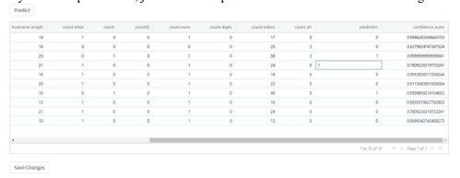
On predicting, we will get the data along with predictions and confidence scores against each prediction. Just validate of the predictions are correct or not. In case of any incorrect predictions, just correct the predicted label and click on save changes.

Slide 16
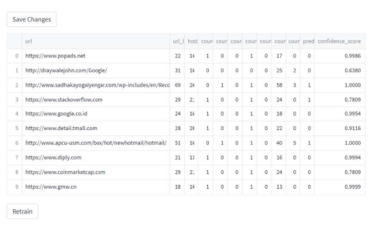
On clicking the save changes button a dataframe will appear with the modified values and it will also get saved in our data folder.

Slide 17
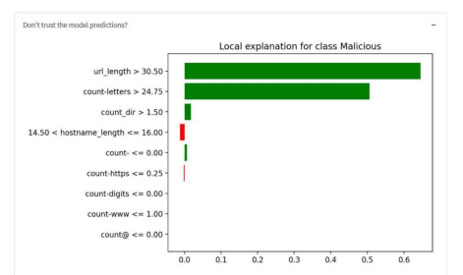
Once we have our modified data saved, we can retrain the baseline model using the new data. We have used Logistic Regression with warm start as True which lets us train the model from where we left at and not retraining from scratch. This helps to reduce computational cost and is fast as well.
After retraining, our baseline model will be modified with the newly trained model and over the next iterations, our model’s performance will improve.
We have used LIME to showcase our model interpretability

Slide 18
Conclusion and Future of URL Data Labelling
Effective data labelling is crucial for improving URL classification accuracy and enhancing online security measures. Continued advancements in machine learning techniques and the development of intelligent labelling tools will shape the future of URL data labelling.

